Slide 1
ROC Curve
By
Dr. S PADMANABHAN

Slide 2
AUC - ROC Curve in Machine Learning
The Receiver Operating Characteristic (ROC) curve and the Area Under the Curve (AUC) are essential tools for evaluating the performance of binary classification models, particularly when dealing with imbalanced datasets.
They provide insights into the trade-offs between sensitivity (recall) and the fallout (false positive rate) and are widely used to evaluate and compare different classification models.

Slide 3
AUC - ROC Curve in Machine Learning
ROC Curve: A graphical representation that shows the performance of a binary classifier at various threshold settings. It plots TPR vs. FPR.
AUC: A scalar value that summarizes the ROC curve into a single number representing the model's ability to distinguish between the positive and negative classes.
A high AUC indicates a good model performance, whereas an AUC of 0.5 suggests the model performs no better than random chance.

Slide 4
What is the ROC Curve?
The ROC curve is a plot that illustrates the diagnostic ability of a binary classifier system as its discrimination threshold is varied. It plots two parameters:
True Positive Rate (TPR)
2. False Positive Rate (FPR)
The ROC curve is created by plotting the TPR against the FPR at various threshold settings. Each point on the ROC curve represents a TPR/FPR pair corresponding to a particular decision threshold.

Slide 5
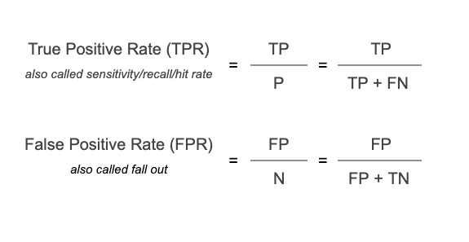
True Positive Rate (TPR) or Sensitivity/Recall: This measures the proportion of actual positives that are correctly identified by the model.

Slide 6
False Positive Rate (FPR): This measures the proportion of actual negatives that are incorrectly identified as positives by the model.

Slide 7
What is AUC?
The Area Under the Curve (AUC) is a numerical representation of the overall ability of a binary classifier to discriminate between the positive and negative classes.
The AUC is calculated from the Receiver Operating Characteristic (ROC) curve, which plots the True Positive Rate (TPR) against the False Positive Rate (FPR) at various threshold levels.
It measures the entire two-dimensional area underneath the entire ROC curve from (0,0) to (1,1).

Slide 8
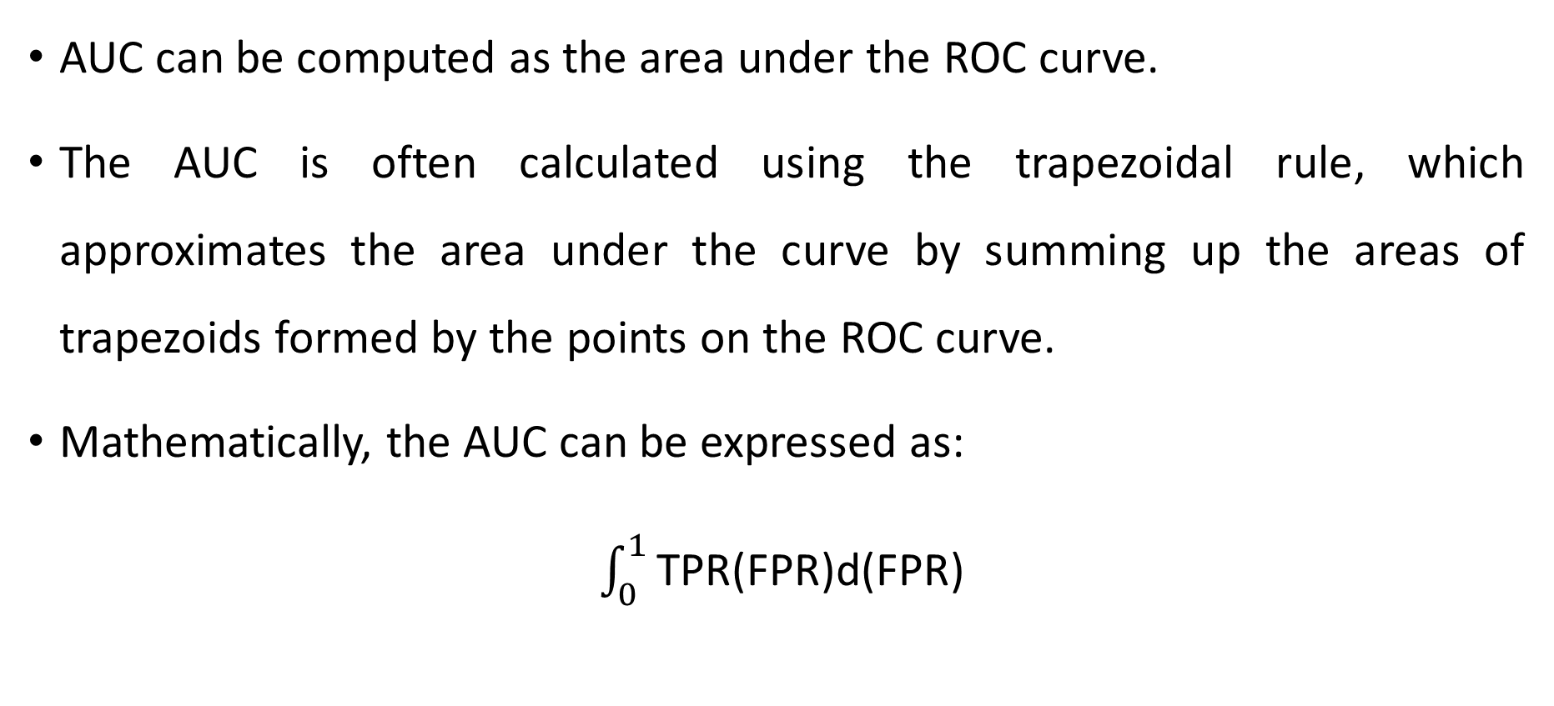
What is AUC?
AUC can be computed as the area under the ROC curve.
The AUC is often calculated using the trapezoidal rule, which approximates the area under the curve by summing up the areas of trapezoids formed by the points on the ROC curve.
Mathematically, the AUC can be expressed as:
$\int_{0}^{1}{\text{TPR}\text{(}\text{FPR}\text{)}\text{d}\text{(}\text{FPR}\text{)}}$

Slide 9
What is AUC?
AUC = 1.0: Indicates a perfect model that distinguishes between positive and negative classes perfectly.
AUC = 0.5: Indicates a model with no discrimination ability, equivalent to random guessing.
AUC < 0.5: Indicates a model that performs worse than random guessing, possibly indicating that the model is systematically incorrect, which might imply that the model has learned something in the reverse direction.

Slide 10
Interpreting the ROC Curve and AUC
High AUC (close to 1): The model is very good at predicting 0s as 0s and 1s as 1s. The curve will be closer to the top-left corner of the plot.
AUC of 0.5: The model's predictions are no better than random guessing. The ROC curve is a diagonal line from (0, 0) to (1, 1).
Low AUC (close to 0.5 or below): The model is poor at distinguishing between the classes. If AUC is significantly below 0.5, the model may be consistently misclassifying classes.

Slide 11
Benefits of ROC and AUC
Threshold Independence: Unlike accuracy, which depends on a fixed threshold, the ROC curve shows the performance across all possible thresholds.
Insight into Performance: It provides a more comprehensive picture of a classifier's performance, especially in cases where classes are imbalanced.
Comparison: AUC allows for easy comparison of different classifiers, even if they use different thresholds.

Slide 12
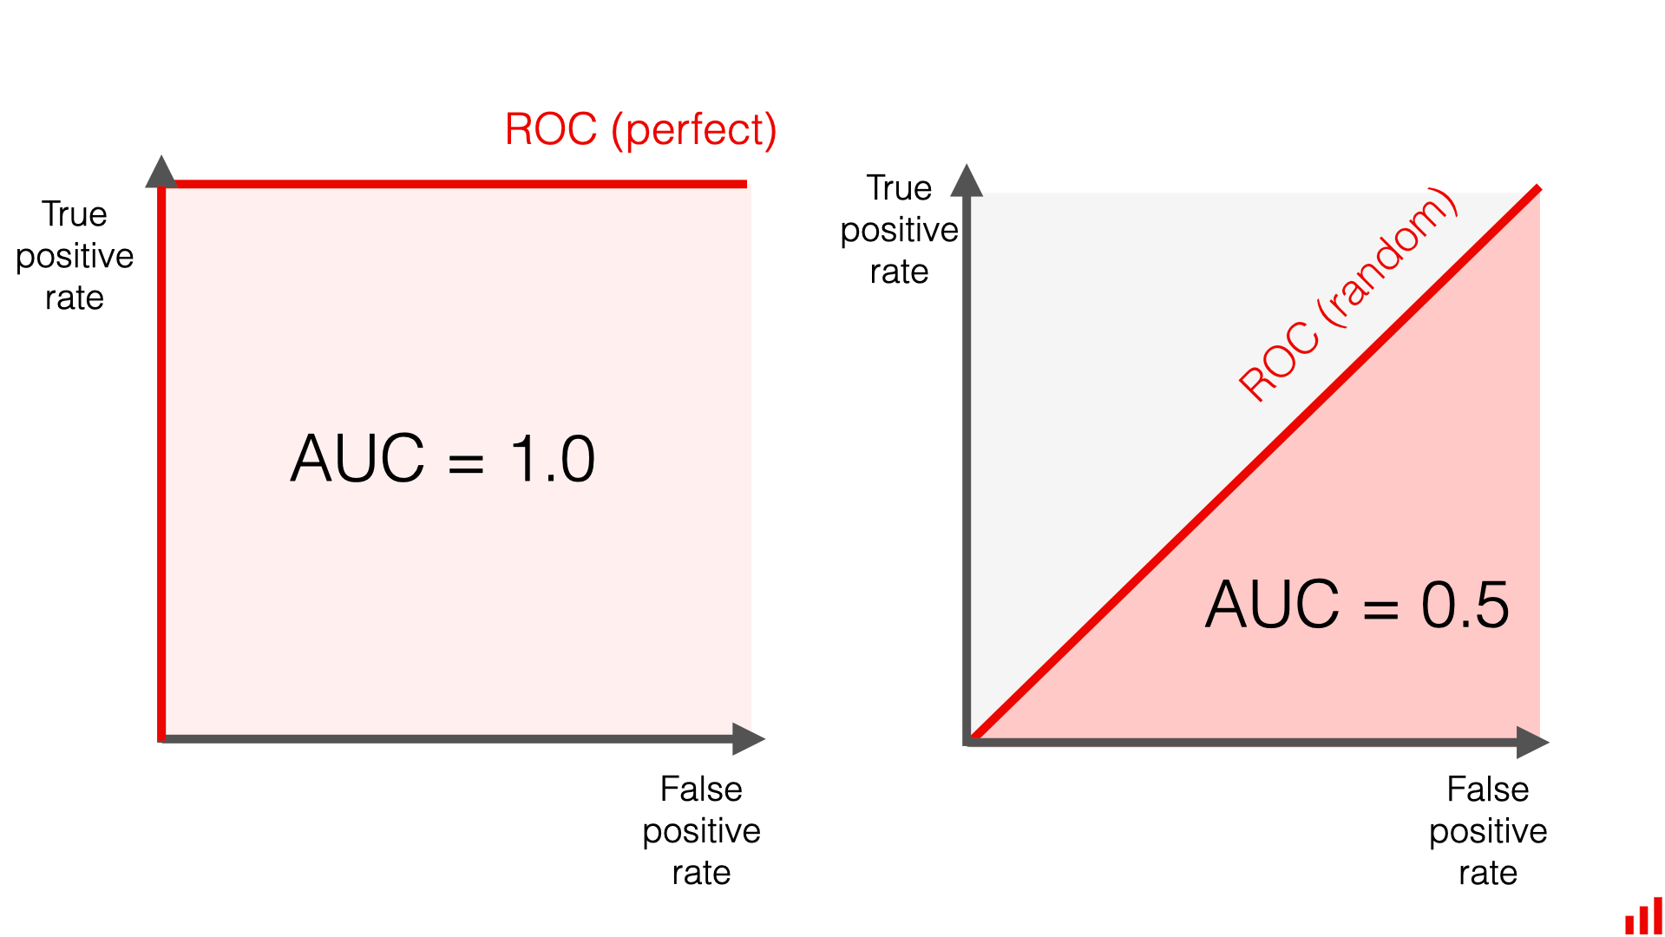

Slide 13
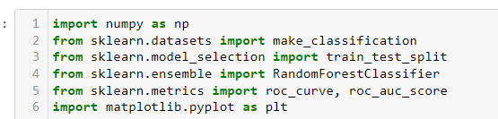
Practical Example Using Python
Below is an example demonstrating how to generate a ROC curve and calculate the AUC using Python with scikit-learn:

Slide 14
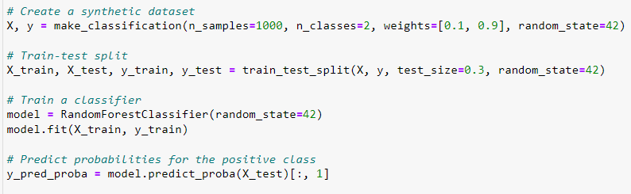

Slide 15
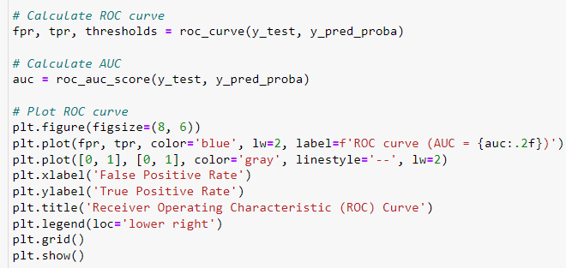

Slide 16
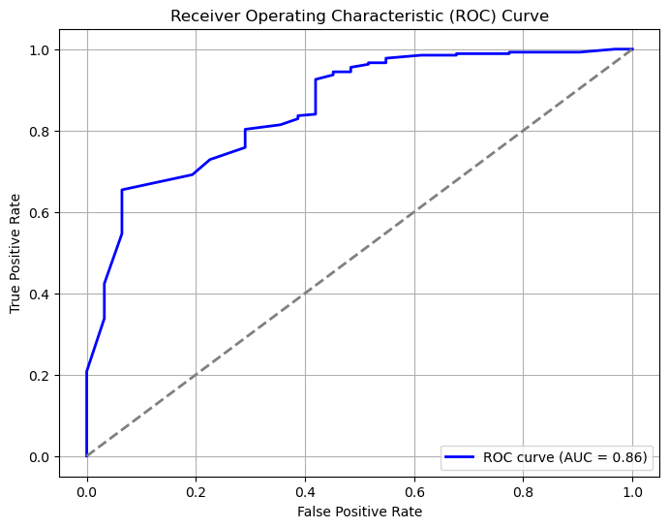

Slide 17
An AUC (Area Under the Curve) of 0.86 indicates that the binary classification model has a good ability to distinguish between the positive and negative classes.
Interpretation:
AUC = 0.86 means that if we randomly select one positive instance (from the positive class) and one negative instance (from the negative class), there is an 86% chance that the model will correctly rank the positive instance higher than the negative one in terms of predicted probability.

